Slide 1

Codergirl – Frontend
Unit 2 - Class 8
January 4, 2021
Notes:
1

Slide 2
Agenda
Section 13 – Observables
Studio – Observables, Assignment # 2
https://academind.com/tutorials/
Notes:
2

Slide 3
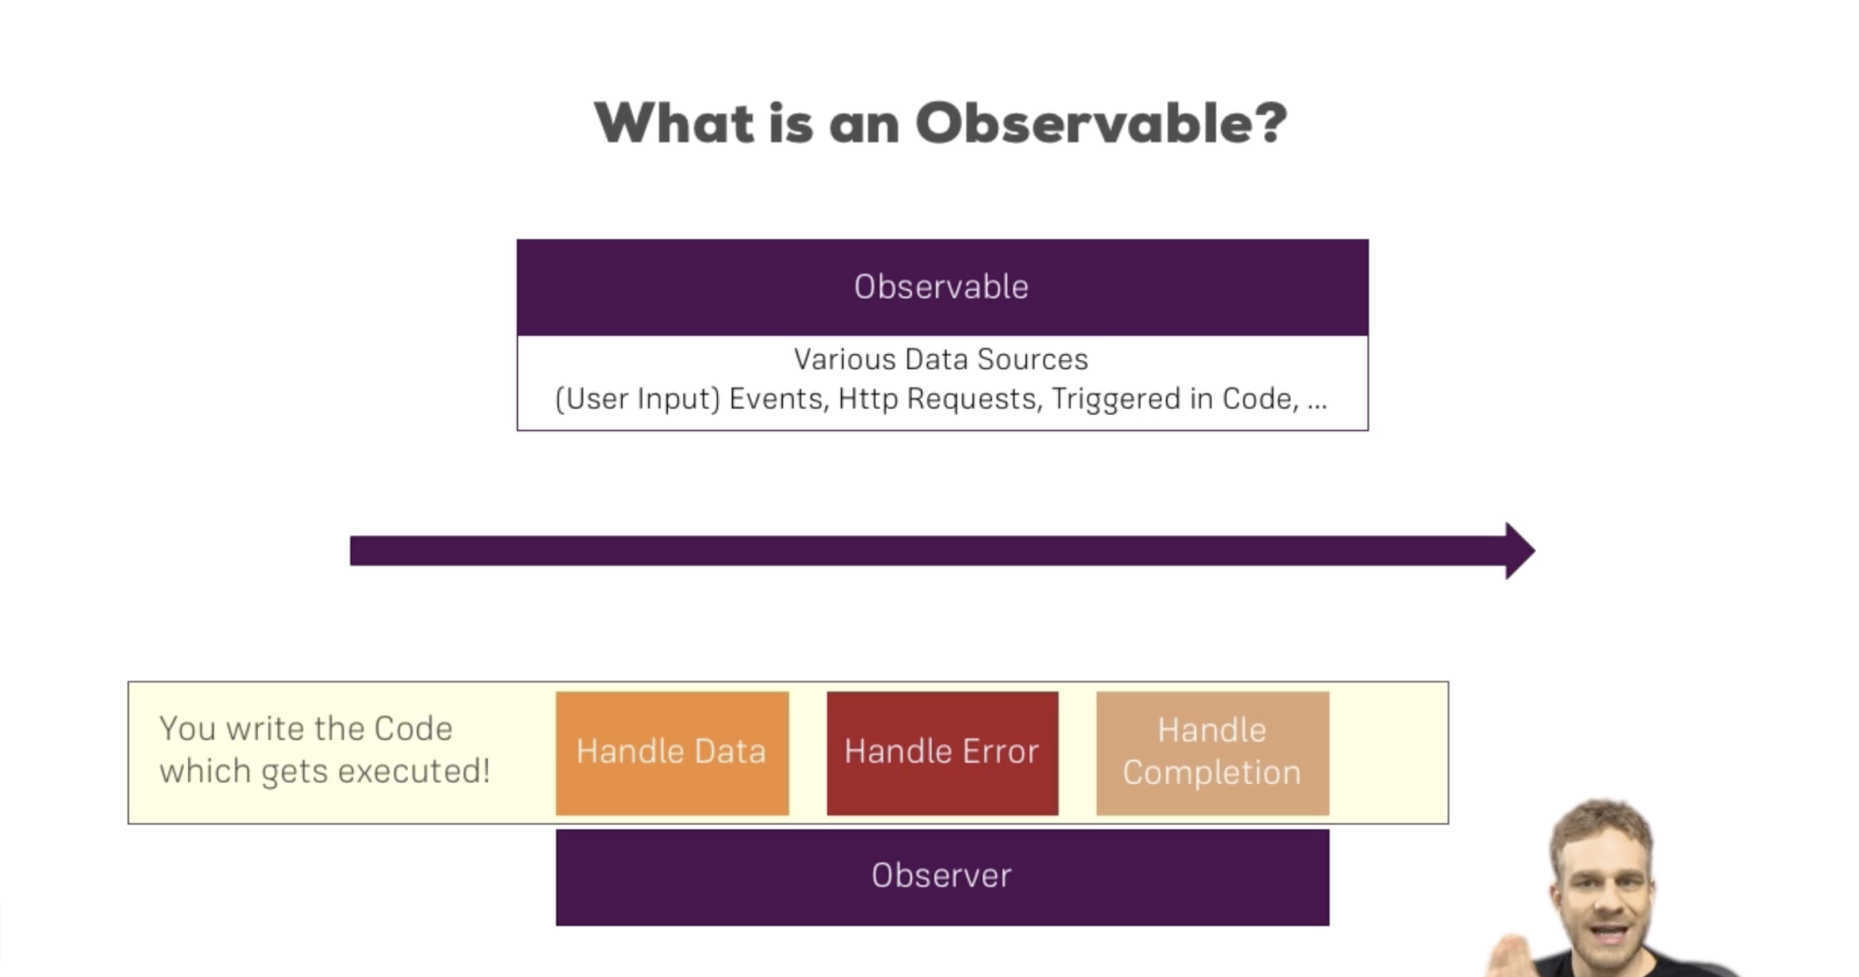
Observables
Notes:
Used to handle asynchronous tasks. Alternative to promises and callbacks. Advantage of observables is the operators.
3

Slide 4
Observables
params is an observable to which you subscribed
Stream of data that you subscribe to, and when data changes you get informed
Notes:
4

Slide 5
Creating an Observable
observable is added by package called rxjs listed in package.json
Notes:
5

Slide 6
Creating an Observable
Observables can keep emitting value and to prevent memory leaks you should unsubscribe.
Notes:
6

Slide 7
Angular provided Observable
These are managed by Angular and the framework takes care of them.
Notes:
7

Slide 8
Real custom Observable
Notes:
8

Slide 9
Error handling
After Observable throws an error it stops.
Notes:
9

Slide 10
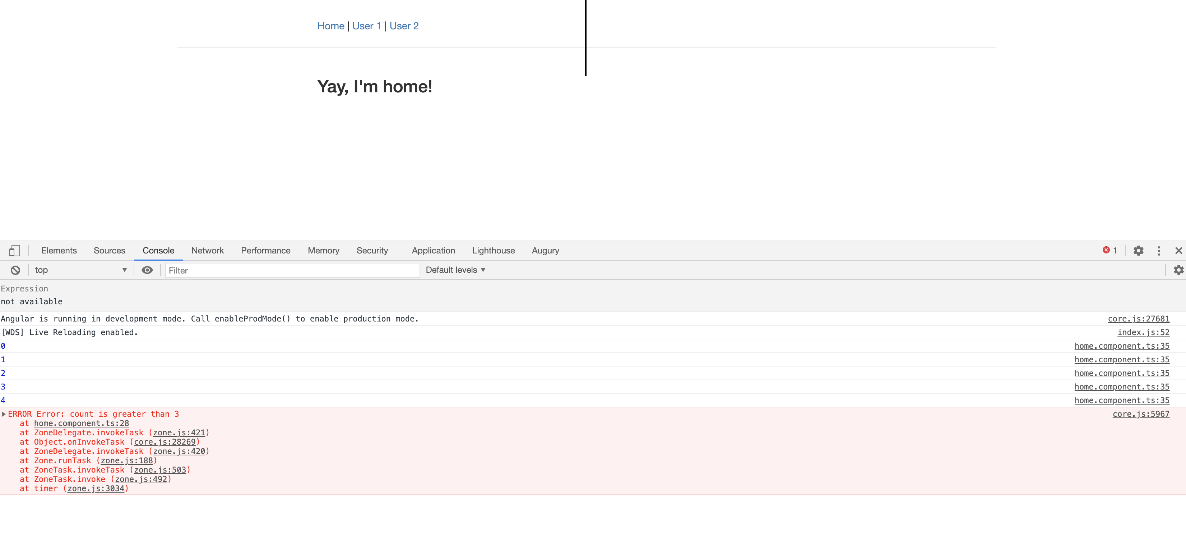
Error handling
Notes:
10

Slide 11
Observer completion
After Observable completes it stops and does not emit any more events.
Notes:
11

Slide 12
Observer completion
Completed does not get called when an error occurs as error cancels an observable without completing it.
Notes:
12

Slide 13
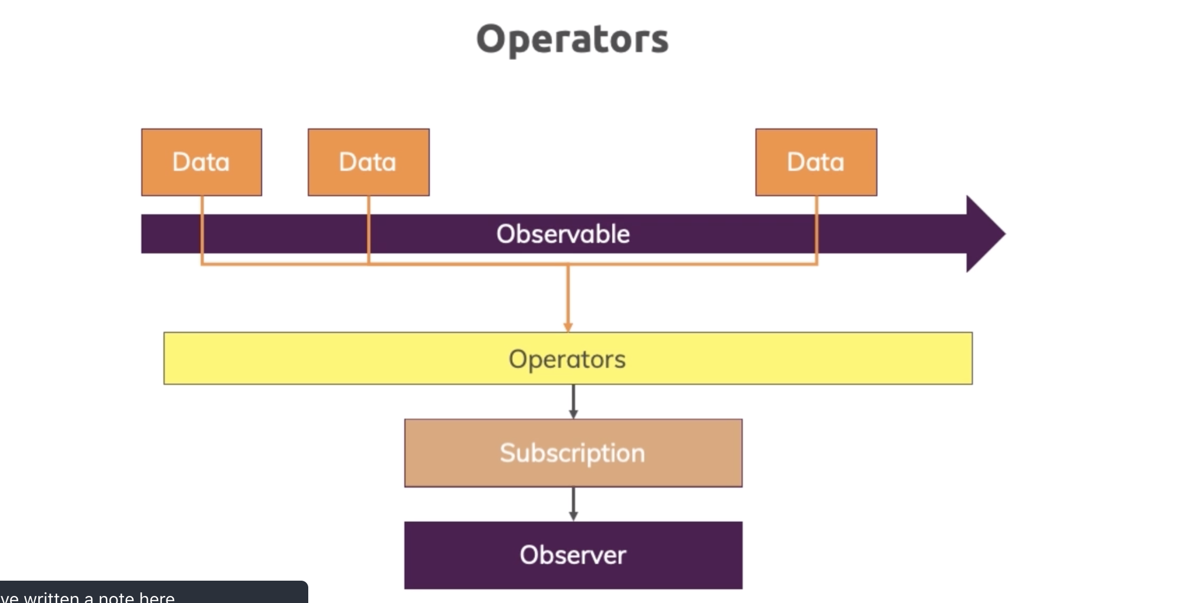
Operators
Notes:
13

Slide 14
Operators Example - Map
Notes:
Every observable has a pipe method.
14

Slide 15
Operators Example – Filter https://www.learnrxjs.io/learn-rxjs/operators
Notes:
15

Slide 16
Using Event Emitter
Add an activated button on user component and when the button is clicked then it should display activated on app component. We accomplish this using services.
Notes:
16

Slide 17
Using Event Emitter
Notes:
17

Slide 18
Using Event Emitter
Notes:
18

Slide 19
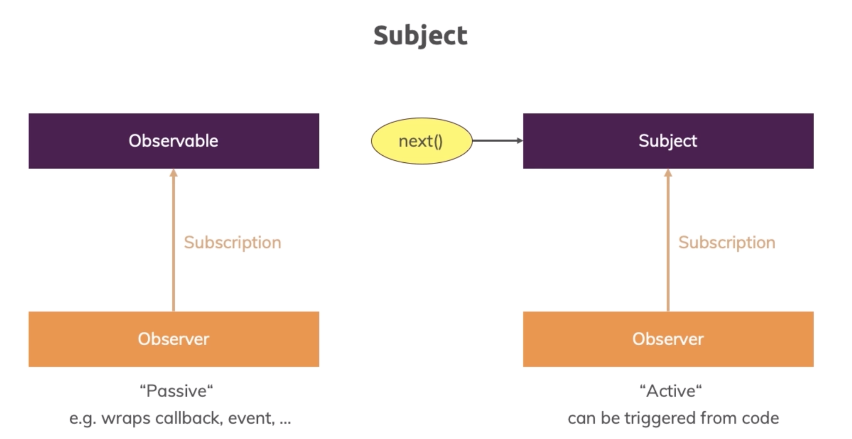
Notes:
19

Slide 20
Using Subject
Notes:
20

Slide 21
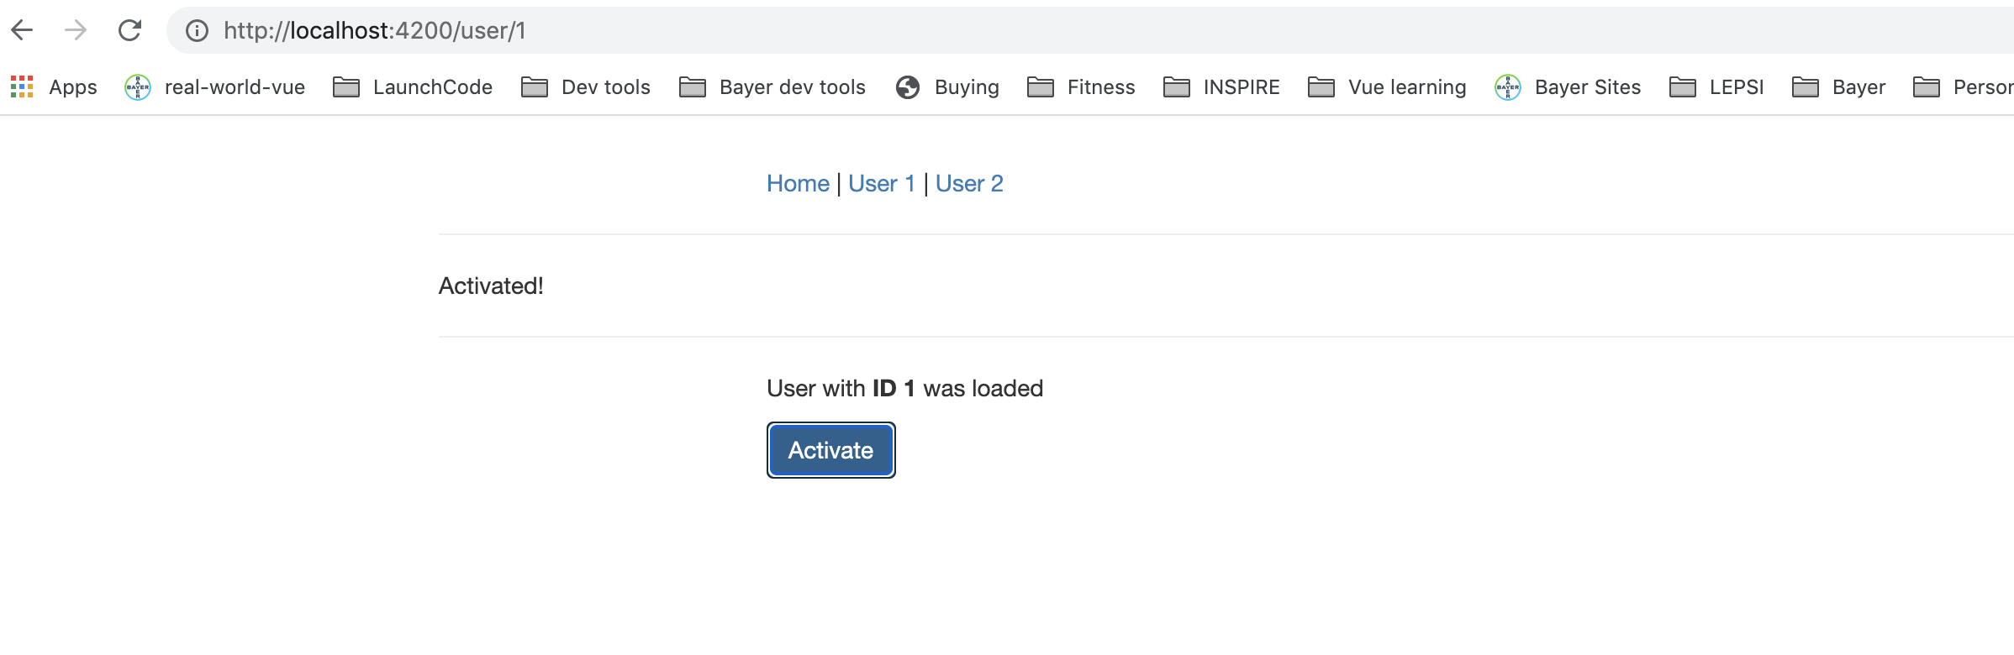
Using Subject
Notes:
21

Slide 22
Using Subject
Notes:
22

Slide 23
Why use Subject
More efficient.
Provide Cool operators.
Cannot use subject instead of @Output EventEmitter.
Subjects are only to use across Components via services.
Notes:
23

Slide 24
Questions?

Slide 25
Class 8 Studio
Steps
Section 14: Observables & Project
Demo your project/GA#2 to your Mentor

